Slide 1

SSID: WWCode
Password: password
Notes:
Please remove this slide when sharing the document to the public

Slide 2
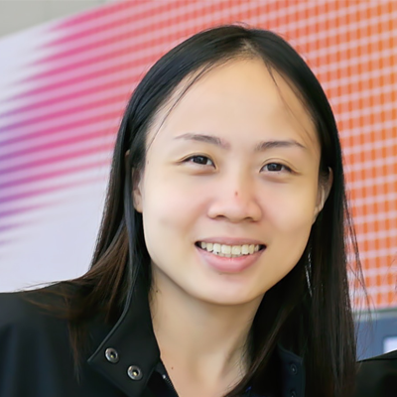
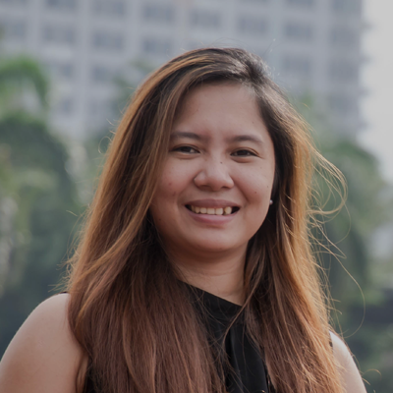
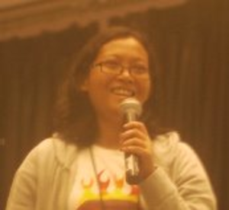
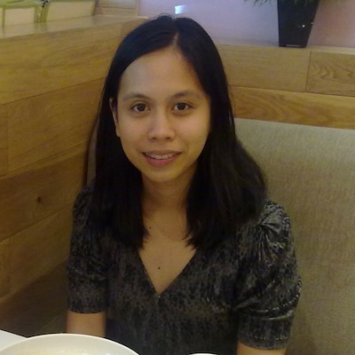
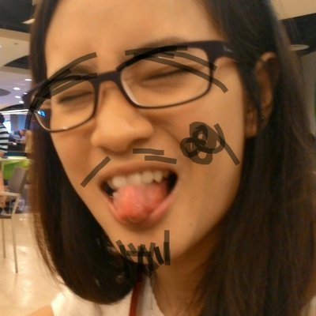
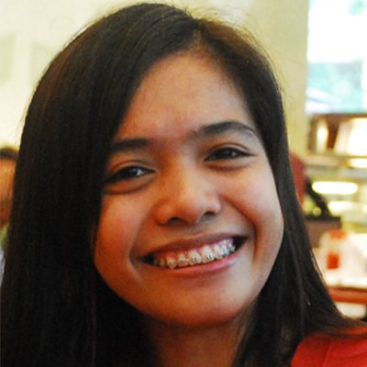

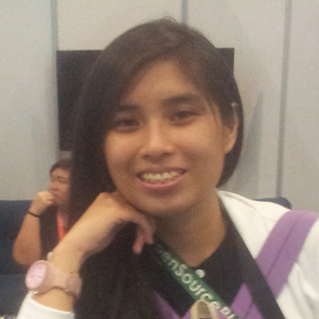
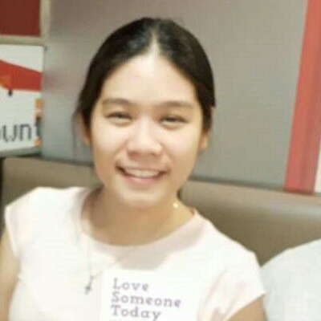
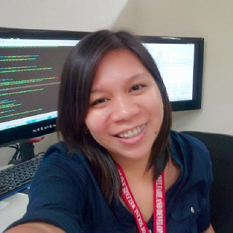
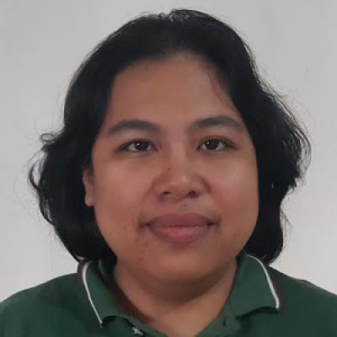
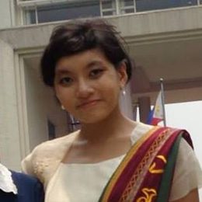
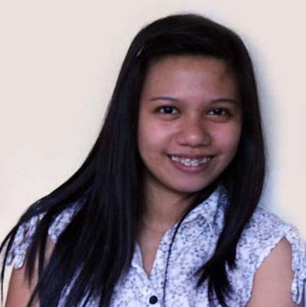
iOS STUDY GROUP
Twitter: @wwcodemanila
FB: fb.com/wwcodemanila
#WWCodeManila
#iOS #Swift
#StudyGroup

Slide 3
Ciela Salazar
iOS Developer
Sprim
Notes:
Please use only the three colors for the content.

Slide 4
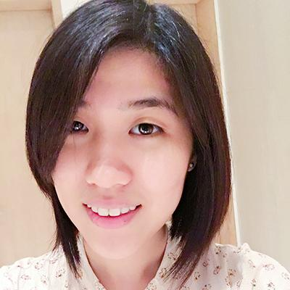
Steffi
iOS Developer
Deal Grocer
Notes:
Please use only the three colors for the content.

Slide 5
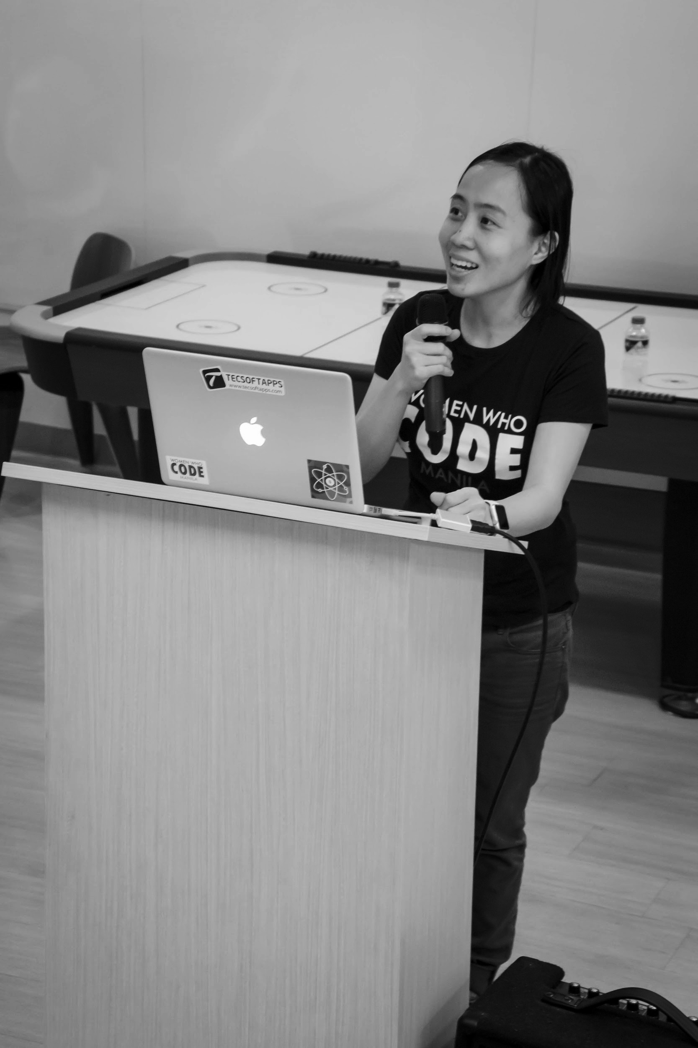

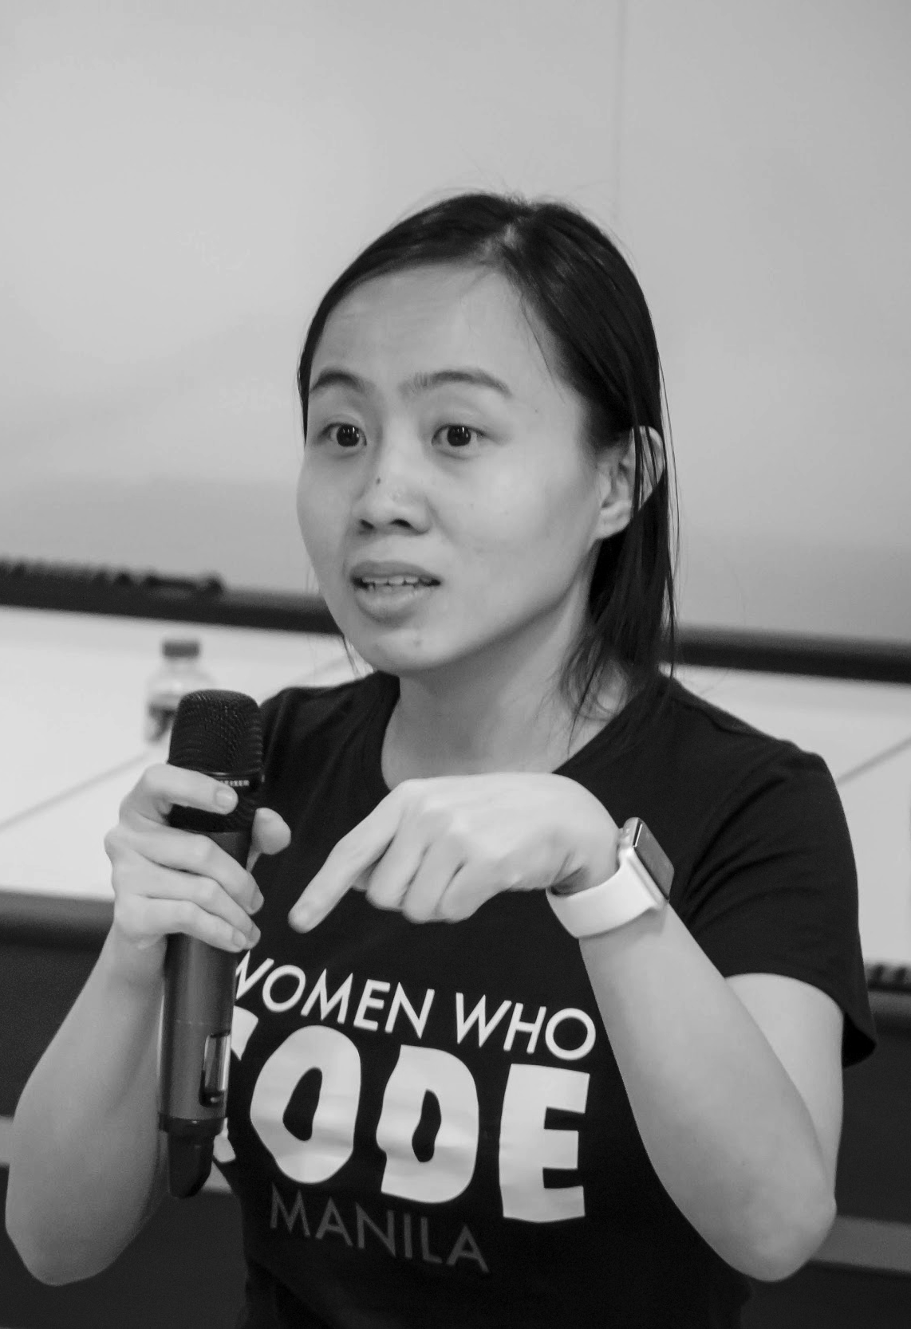
OUR MISSION
Inspiring women to excel in technology careers.

Slide 6
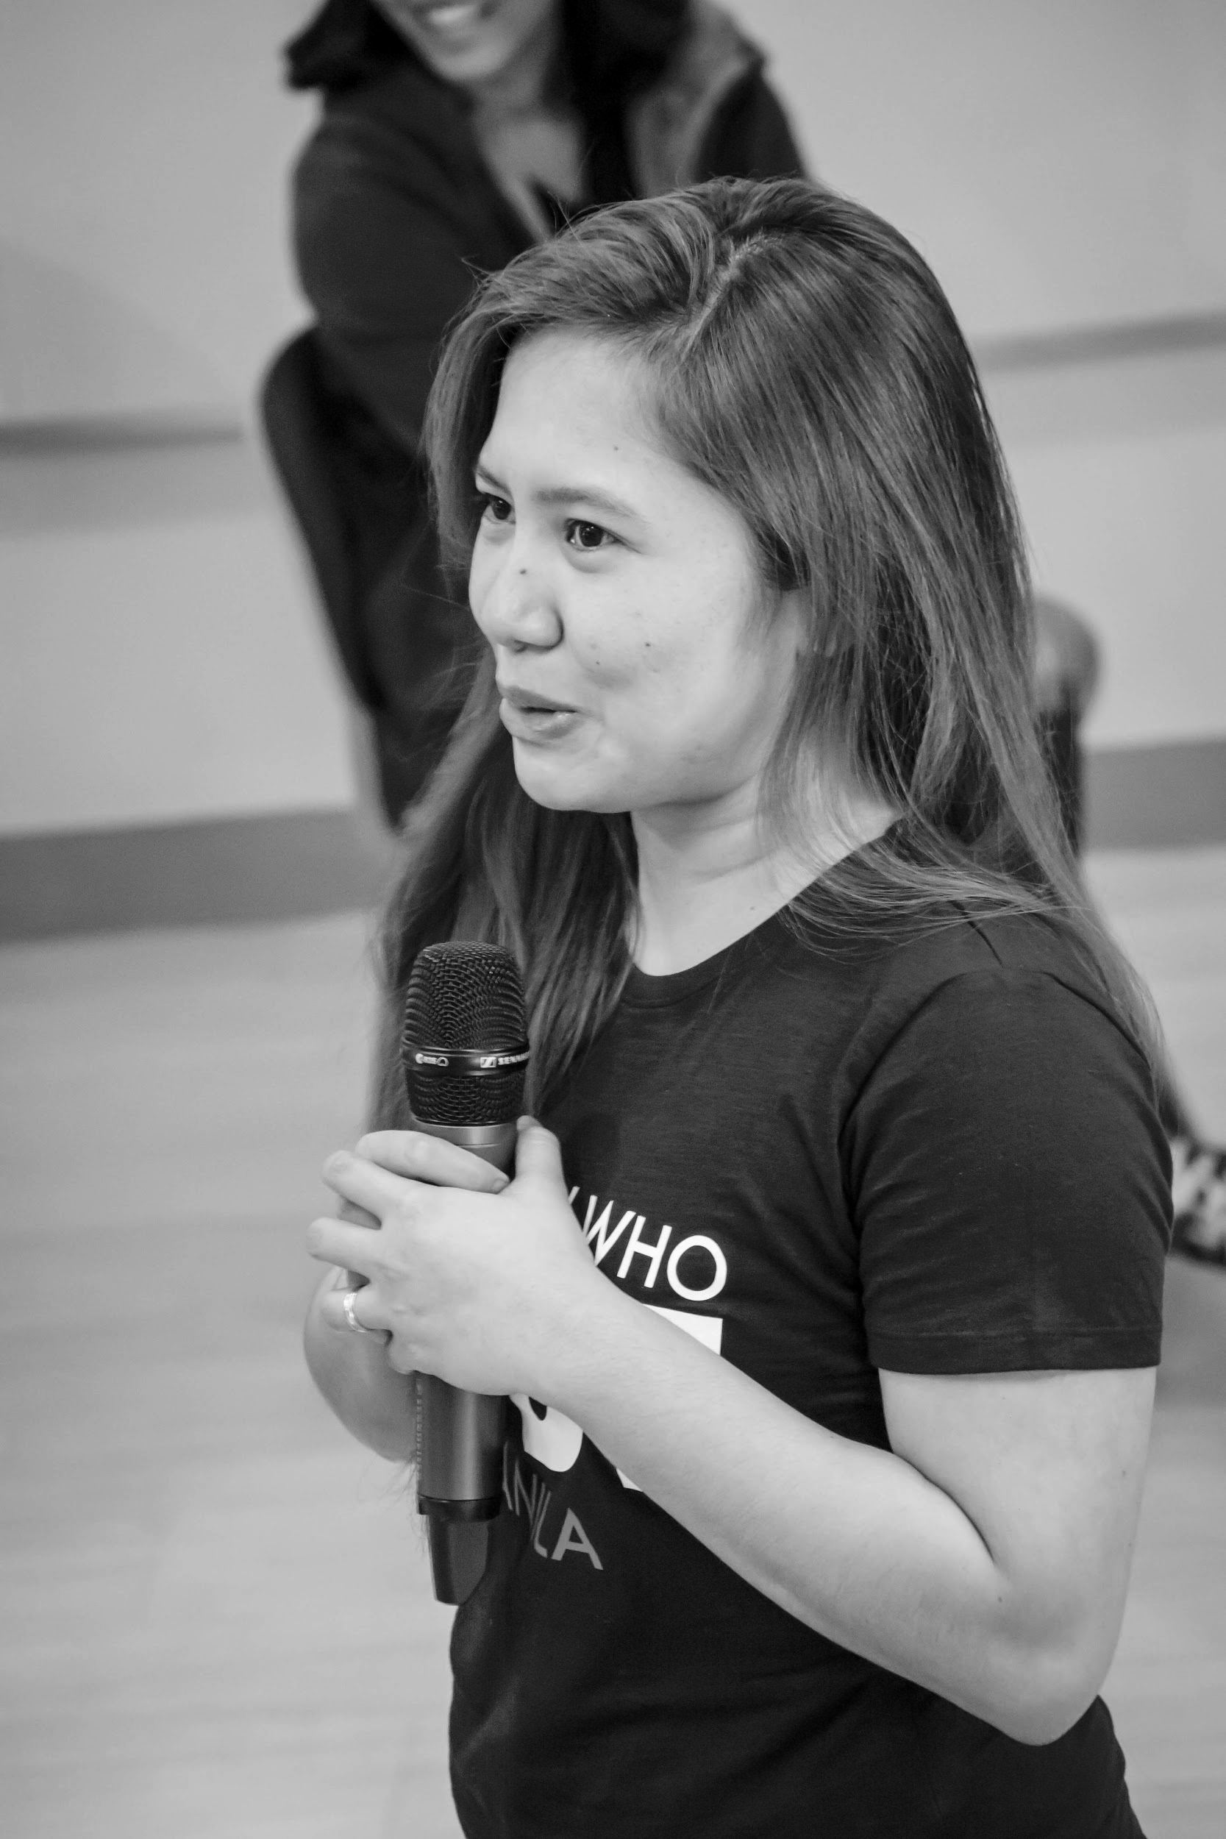
OUR VISION
A world where women are representative as technical executives, founders, VCs, board members and software engineers.

Slide 7
STUDY GROUP
Study groups are events where women can come together and help each other learn and understand a specific programming language, technology, or anything related to coding or engineering.

Slide 8
GUIDELINES
If you have a question, just ask
If you have an idea, share it
Make friends and learn from your study groupmates
Do not recruit or promote your business

Slide 9
New Member’s Introduction

Slide 10
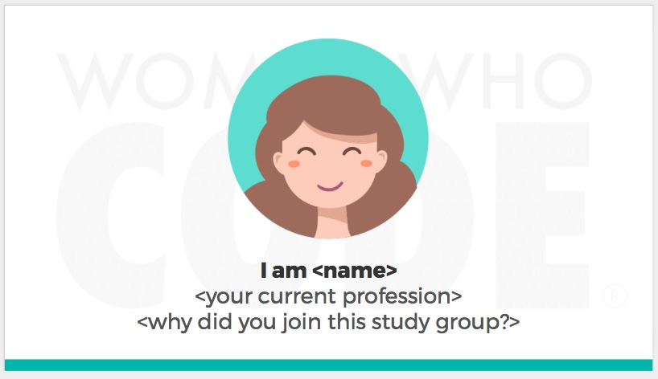
Notes:
Please use only the three colors for the content.

Slide 11
SHOW & TELL
Notes:
Please use only the three colors for the content.

Slide 12
TOPIC FOR TODAY
Notes:
Please use only the three colors for the content.

Slide 13
Log in on iOS: Best Practices
Notes:
Please use only the three colors for the content.

Slide 14
Why Login?
Allows user to control profile and personalization (Social Media App)
Keep personal data:
Messages (Messenger, Slack, Viber, Telegram)
Finances (Bank Apps, Splitwise)

Slide 15
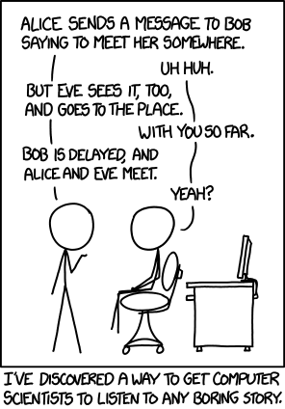

Slide 16
App Security
Our main priority as developers is to make sure that NOBODY accesses user info without their permission
Think Keychains, Encryption, Biometrics
Encryption != Base64

Slide 17
Ways to Store Data
Core Data – applicable for big chunks of information
UserDefaults – requires key-data to store
FileManager – saves file data in app
Memory (static let, var) – keeps when app is in forground, removes when app is killed
Keychains – provides secure way to store data, recommended by Apple

Slide 18
Account verification
It is not advised to do verification on the Client side
Server side is your friend (Backend Engineers)
Use access tokens

Slide 19
Cryptography
Apple has CommonCrypto – a library that holds cryptography methods for developers to use
https://github.com/soffes/CommonCrypto

Slide 20
Partner/Group/Individual Exercise
Notes:
Please use only the three colors for the content.

Slide 21
Partner/Group/Individual Presentation
Notes:
Please use only the three colors for the content.

Slide 22
Assignment
Notes:
No required

Slide 23
Did you know?
You can customize a UITableViewCell by either:
creating a UITableViewCell Subclass
Create a Nib and load it as a custom UITableViewCell
You can add segues on tap of UITableViewCells to direct to different View Controllers
You can swipe to the left to delete or edit the cell that you choose. (Hint: It is also part of UITableView Protocol)
Use sections instead of rows to contain the data source
Remember: Try and Try until you succeed 👍

Slide 24
References
Notes:
Please use only the three colors for the content.

Slide 25
https://www.raywenderlich.com/9240-keychain-services-api-tutorial-for-passwords-in-swift
https://www.raywenderlich.com/129-basic-ios-security-keychain-and-hashing
https://www.raywenderlich.com/236-how-to-secure-ios-user-data-the-keychain-and-biometrics-face-id-or-touch-id
https://developer.apple.com/documentation/localauthentication
https://developer.apple.com/library/archive/documentation/System/Conceptual/ManPages_iPhoneOS/man3/Common%20Crypto.3cc.html
https://developer.apple.com/library/archive/documentation/Security/Conceptual/cryptoservices/CryptographyConcepts/CryptographyConcepts.html#//apple_ref/doc/uid/TP40011172-CH8-SW1

Slide 26
T.I.L.
SHARE IT!
In front!
On Twitter: @wwcodemanila
Or FB: fb.com/wwcodemanila
Don’t forget to tag WWCodeManila so we can retweet or share it.
Notes:
Please use only the three colors for the content.

Slide 27
Feedback Form
https://goo.gl/YzSqcS
Please don’t rate the event on meetup.
Not helpful. It is best to just tell your concerns via the feedback form. We are a building a community not a Yelp restaurant.
Notes:
Please use only the three colors for the content.

Slide 28
THANK YOU :)
Notes:
Please use only the three colors for the content.

